Slide 1
👋 Hello & Welcome
⏳ This session will begin shortly.
While you wait, please download the slides for today’s session from the LevUL up website.
In association with:

Slide 2
Recording
This session will now be recorded. Any further information that you provide during a session is optional and in doing so you give us consent to process this information.
These recordings will be stored by the University of Limerick for one year and may be published on our website during that time.
By taking part in a session you give us your consent to process any information you provide during it.

Slide 3
Welcome to
Digital Wellbeing
A LevUL up Workshop

Slide 4
Who we are
Jasmine Ryan
UL Student Associate Intern, Enhancing Digital Teaching and Learning (EDTL) project, Centre for Transformative Learning​
David Moloney
UL Project Lead, Enhancing Digital Teaching and Learning (EDTL) project, Centre for Transformative Learning​
COMPANY CULTURE BOOK

Slide 5
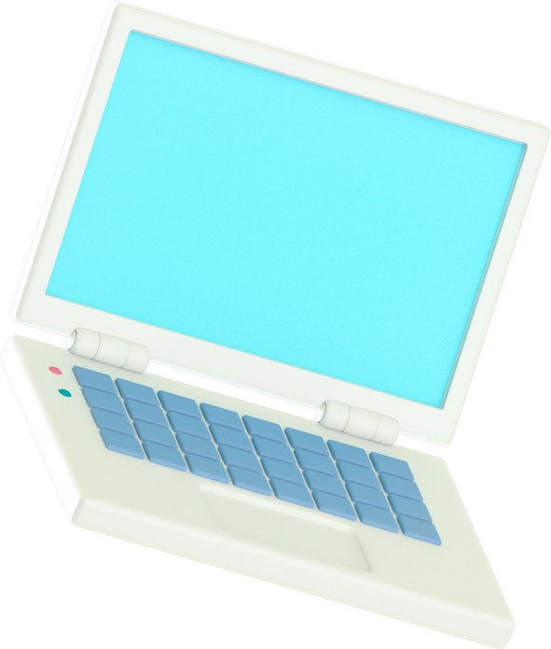
AIMS
Defining "digital wellbeing" means
Managing (or hopefully avoiding) digital burnout
Maintaining a work/life balance
Your Digital Footprint

Slide 6
What is "Digital wellbeing"?
Your digital wellbeing is defined by four paramaters: mental, physical, social and emotional.
“The capacity to look after personal health, safety, relationships and work-life balance in digital settings; to use digital tools in pursuit of personal goals (e.g. health and fitness) and to participate in social and community activities; to act safely and responsibly in digital environments; to negotiate and resolve conflict; to manage digital workload, overload and distraction; to act with concern for the human and natural environment when using digital tools. An understanding of the benefits and risks of digital participation in relation to health and wellbeing outcomes.” (Shah, 2021)
Shah, A., 2021. Defining digital wellbeing - Jisc Building Digital Capability Blog. [online] Jisc Building Digital Capability Blog. Available at: <https://digitalcapability.jiscinvolve.org/wp/2019/09/03/defining-digital-wellbeing/> [Accessed 17 August 2021].

Slide 7
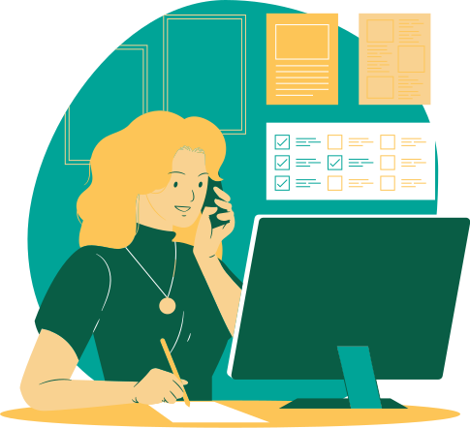
Make technology work for you

Slide 8
Stay Balanced
1
Use time wisely
Check out our Time Management series for tips and tricks on how to manage work and study. Study methods like the Pomodoro, for example, help you maintain focus, structure time, and finish tasks. The better you get at time management; the more free time you have for what you love.
see Tech for Time Management to learn more!
2
Maintain a work/life balance
Once you learn to structure your time well, take the free periods to work on your personal goals. Exercise, read a book, or even start a hobby. Making time for hobbies and relaxation is ideal for tackling burnout, stress, and anxiety.

Slide 9
Avoid Digital Burnout
MANAGE YOUR STUDY AND BREAK TIME.
In Unit 4, "Time Management," we share tips and tricks on how to manage your time with useful applications and software. Make sure to take regular breaks when working; try the Pomodoro Method where you work for 25 minutes and break for 5. Take your break away from the screen: make a cup of tea, get up and stretch, and maybe on your long break go for a walk.
MAKE YOUR PHONE WORK FOR YOU.
We are often bombarded by notifications and endless buzzing. Turn off your phone sometimes or put it on DoNotDisturb mode either while you work or by setting specific times where notifications can't come through. Also, explore apps that help with anxiety or with achieving health goals.
LIMIT SOCIAL MEDIA INTAKE.
I don't need to remind you that excessive consumption of social media is negative for one's mental health and can induce feelings of anxiety and depression. Unplug and unwind from time to time or do a detox of your feed.

Slide 10
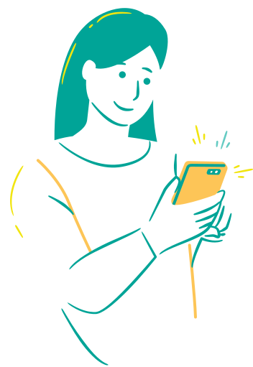
For Your Brain
FocusToDo
MindShift
Study in timed chunks with set breaks; track tasks & see your progress.
Manage stress and anxiety with this CBT programme.
Headspace
Habitica
Take a breather with this meditation app.
Gamify your goals and create habits.
Notes:
From this slide, I will demonstrate how I'm going to use Focus to-do to keep me on track while I begin inputting my syllabi into an Excel document and then inputting dates into Microsoft Word.

Slide 11
For your Body
Believe it or not, taking care of your digital wellbeing has a lot to do with your physical wellbeing. So, it's good there are plenty of applications designed to help you achieve your personal, social, and educational goals.
With Charity Miles, every step makes a difference. Do good for yourself & someone else!
Bluelight filters like F.lux are great for reducing eyestrain & improving sleep.

Slide 12
Protecting Yourself
e-Safety
Tips and Tricks

Slide 13
Your
Digital
Footprint
79%
% of internet users around the world feel they have completely lost control over their personal data.
67%
Your digital footprint is the trail you leave behind as you browse the web and engage with sites - but, its not just site cookies! this information includes login information, impressions, and various data. Understanding and managing your digital footprint is important to protect yourself from hackers and unwanted scrutiny.
7% of internet users worldwide are more concerned with their online privacy than they’ve ever been.
33%
% of email and social media users were victims of at least one cyberattack in 2018.
Vuleta, B., 2021. 18 Chilling Privacy Statistics in 2021. [online] Legaljobs.io. Available at: <https://legaljobs.io/blog/privacy-statistics/> [Accessed 17 August 2021].
Notes:
Lead slide ->
Will then transition to live demonstration of me inputting ssignment dates into Microsoft Excel followed by Google Calendar

Slide 14
Data Detox Kit
DataDetoxKit is a website that gives you tips on how to manage and delete your data online; how to protect your privacy; and how to be more aware of digital content and its influence on your wellbeing.
Top tips:
Delete apps/accounts you aren't using
Secure your social media accounts
Control your smartphone data
Notes:
*Walk through Data Detox website
How many apps do you have on your phone? Do you get a lot of promotional mail? How many sites have your data? What do other people know about you?
*Clear cookies, walk through DataDetox steps, then search myself on social media.

Slide 15
Renovate your Social Media
Use the browser instead of the application
Update your ad preferences
Reduce publicly available data
Declutter your accounts
Separate your accounts
Notes:
App instead of Browser
* Makes it easier for companies to track you/share information across services
Update ad preferences
Ads based on data from partners → Continue → Not allowed → Save
Ads based on your activity on Facebook Company Products that you see elsewhere → No
Ads that include your social actions → No one
Reduce publicly available data
Facebook:
On your computer, log into Facebook and go to Settings → Privacy.
Select Friends for Who can see your future posts?
Select Friends for Who can look you up using the email address/phone number you provided?
Select No for Do you want search engines outside of Facebook to link to your Profile?
Now go to Settings → Timeline and Tagging
Select Only Me or Friends for Who can see posts you’ve been tagged in on your timeline? and for Who can see what others post on your timeline?
Instagram:
On the app, go to Settings → Privacy and Security → Account Privacy → next to Private Account, tap the toggle → in the pop up, tap OK to confirm.
Declutter your accounts
Facebook:
From the drop-down menu in the top right corner, select Activity Log. Scroll down through all your activities and choose a few items to delete (click the pencil icon on the post itself). Pick things that you wouldn’t miss anyway and set your own goal: 5 photos, 10 comments, 15 posts – how many can you live without? Great; now add 4 more to that number and get going!
Un-tag yourself in all those pictures you wouldn’t miss. Once you’re done, un-tag yourself in some more.
You may find that your deep-clean is so satisfying that you don’t want to stop. But when you do, commit yourself to removing more posts or photos over the next few weeks.
Instagram:
On your profile page, tap on the icon to see photo’s you’ve been tagged in. Start with a picture you wouldn’t miss.
Tap once to view the image → tap once on the image to view the tag(s) → find your name tag and long tap on it → in the pop-up select either Hide or Remove
Separate your accounts

Slide 16
10
Access, Sharing & Safety
Accounts, Access & Logins
Safety and Security
File sharing
Notes:
This unit of the Sulis gives you information and tutorials on how to protect your computer and data effectively.
I will walk through the Sulis page and present the various options and links for securing your computer.
*Logging into UL databases
*Using strong passwords
- Chrome has a good option to check the security of your passwords.
*Password managers
* Downloading Antivirus
* Enabling firewall
* Viewing ITD resources on Security & Safety

Slide 17
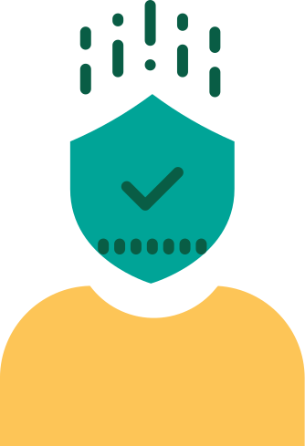
12
Resources
For more resources on how to improve your digital wellbeing check out our Digital Skills Awareness course.
Today's slides and links can be found in Unit 4: Getting Organised, Digital Wellbeing.
This work is licensed under a Creative Commons Attribution-NonCommercial 4.0 International (CC BY-NC 4.0)

Slide 18
Reflection & Questions

Slide 19
Thank you!

